Slide 1

TITLE
HR ANALYTICS
Overview
The Aim of an HR attrition data analytics project is to analyze and understand the factors and patterns associated with employee attrition within an organization. The primary goal is to use data-driven insights to reduce attrition rates, improve employee retention, and make more informed HR-related decisions.
Mr. Suraj Kumar (Assignment Team)
Mr. Arif(Mentor)
Group Members(Group 4)
Mr. Shoubhik Paul
Ms. Kalyani Ravindra Deshmukh
Mrs. Sneha Mangesh Mahulkar
Gaurav Pawar
Vishal Sharma
A Laxmi Priya

Slide 2
Objectives
Insight Generation: The fundamental goal of this project is to extract valuable insights and knowledge from data. These insights can be used to make informed decisions, identify patterns, and gain a deeper understanding of the subject matter.
Data Quality Improvement: Projects also focus on improving data quality. The objective is to clean, transform, and enhance data so that it's more reliable and suitable for analysis.
Create Interactive Dashboard in Power Bi , Tableau and Excel to communicate findings effectively to clients.
Reporting and Recommendation : Summarize findings in a clear and concise presentation and give suggestions to improve the satisfaction of employees.
Retention Strategies: The project is geared towards developing strategies to retain employees, such as better training, mentorship, improving work-life balance, and competitive compensation.
01
02
03
04
05

Slide 3
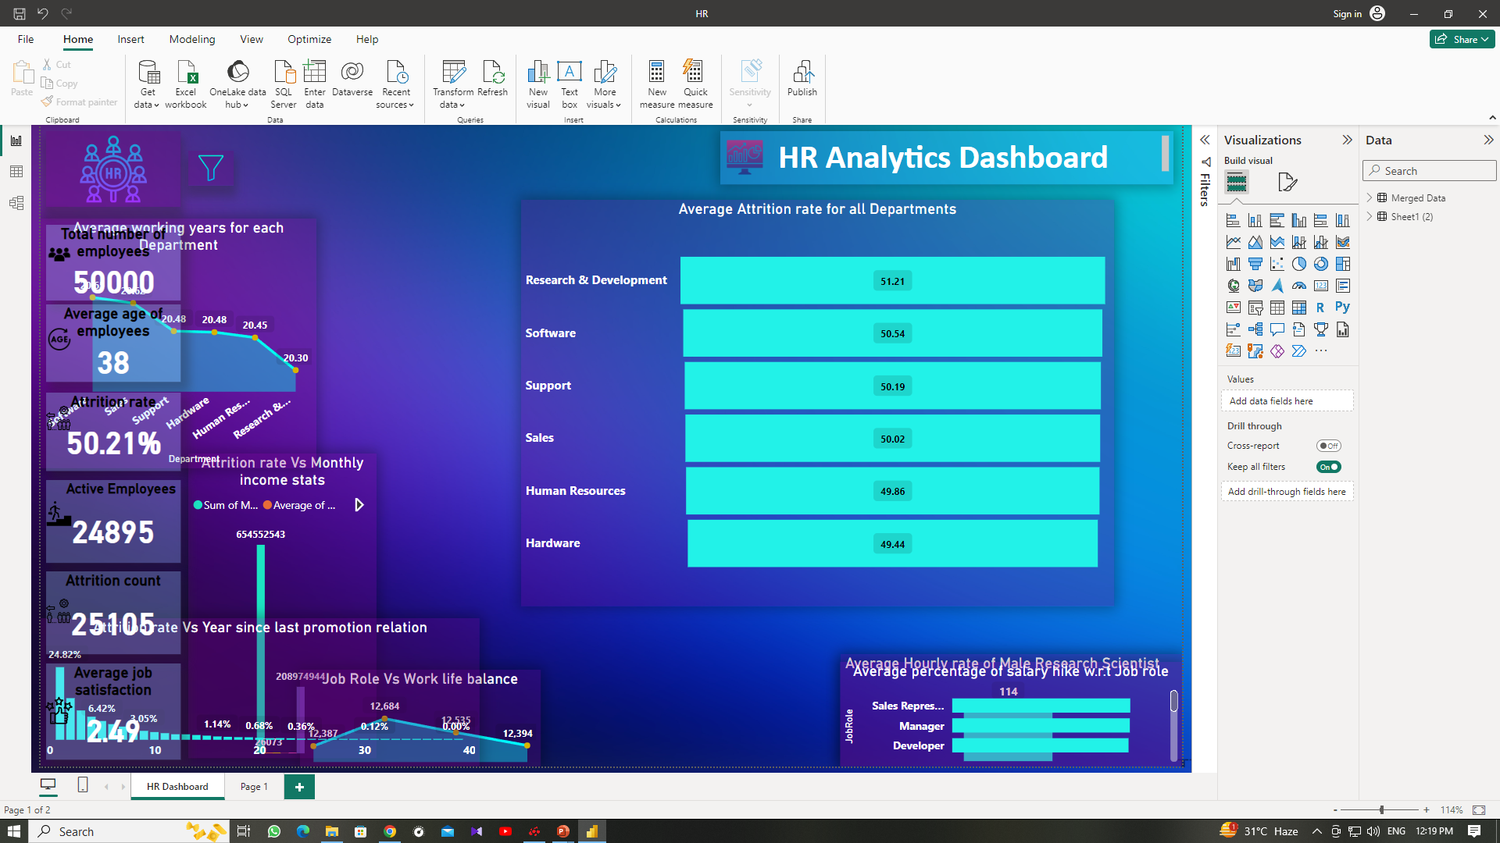
KPI 1-Average Attrition rate for all Departments
Department Breakdown: The data is categorized into several departments, including Research & Development, Sales, Software, Human Resources, Support, and Hardware. This breakdown allows see attrition rates for each department separately.
The "Count of Attrition" represents the number of employees who have left the respective departments. This is essential for understanding the scale of attrition in each department.
In this data, Research & Development, Software, and Human Resources have attrition rates of 51%, while Sales, Support, and Hardware have rates of 50%. This suggests that Research & Development and Software have slightly higher attrition rates compared to the others.
Actionable Insights: High attrition rates can be indicative of various issues within a department, such as dissatisfaction with work conditions, management, or compensation. HR and department heads may need to investigate the causes and implement retention strategies in departments with high attrition rates.
The high attrition rates in Research & Development and Software departments might indicate some challenges in retaining employees in these technical roles. This could be due to factors like competition, demanding work environments, or possibly inadequate retention strategies.
Stability in Hardware: The Hardware department has the lowest attrition rate at 49%, which suggests that this department might have more stable employment conditions or effective retention strategies in place.

Slide 4
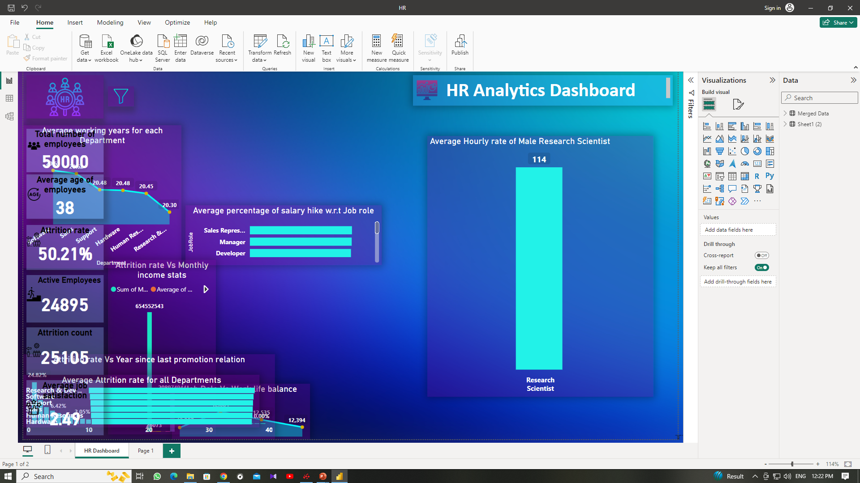
KPI 2-Average Hourly rate of Male Research Scientist
Data shows that Male Research Scientist has 114 avearge hourly rate.
In conclusion, the data shows a small difference in average hourly rates between male and female research scientists.
To address this, further analysis is needed to determine the root causes, and steps should be taken to ensure fair and equitable compensation for all employees, regardless of gender. This may involve policy adjustments, performance evaluations, and promoting diversity and inclusion in the workplace.

Slide 5
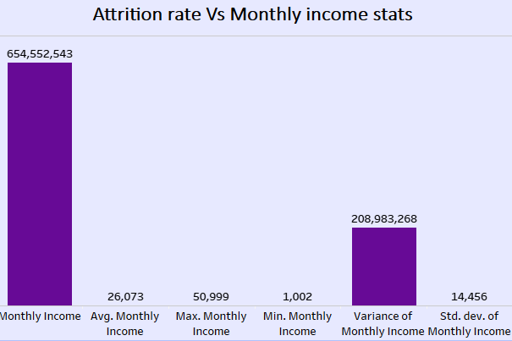
KPI 3-Attrition rate Vs Monthly income stats
Total Monthly Income: The sum of monthly incomes for the employees who left the organization is 654,552,543 units of currency. This represents the total amount of money paid to these employees before their departure.
Average Monthly Income: The average monthly income for these departing employees is 26,073 units of currency. This figure indicates the typical income that employees who left were receiving per month.
Maximum Monthly Income: The highest monthly income among the departing employees was 50,999 units of currency. This reflects the highest level of compensation among those who left the organization.
Minimum Monthly Income: The lowest monthly income among the departing employees was 1,002 units of currency. This represents the lowest level of compensation among those who left.
High-Earning Departures: The presence of departing employees with very high monthly incomes might indicate that the organization is losing valuable, well-compensated talent. This can be a concern, especially if these departures result in a loss of expertise and experience.
Potential Retention Issues: The fact that some employees were earning lower incomes before leaving may indicate potential dissatisfaction with their compensation or other aspects of their job. Low income compared to the industry standard or a lack of opportunities for salary growth can be factors contributing to employee turnover.

Slide 6
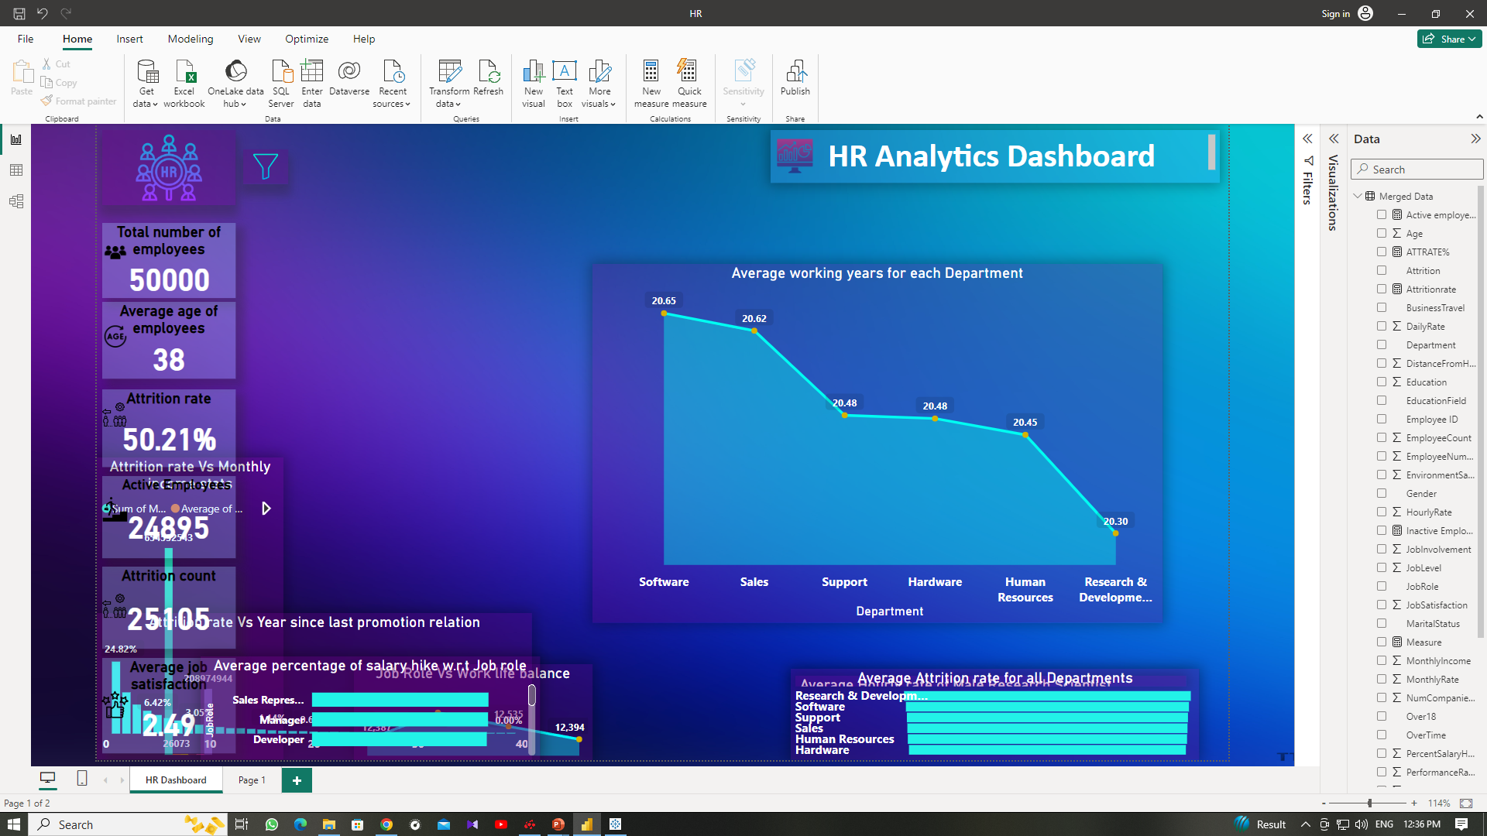
KPI 4-Average working years for each Department
Consistency in Average Total Working Years: The data indicates a relatively consistent average total working years across different departments, with values ranging from 20.30 to 20.65 years. This suggests that, on average, employees in these departments have a similar level of overall work experience.
Stability and Experience: The close alignment of average total working years among these departments indicates that the organization may have a stable and experienced workforce. This stability can be an asset, as experienced employees often bring valuable skills and expertise to their roles.
The Human Resources and Research & Development departments have the lowest average total working years (20.45 and 20.30 years, respectively). This suggests that these departments may have a slightly less experienced workforce compared to others.
In contrast, the Sales and Software departments have slightly higher average total working years (20.62 and 20.65 years, respectively). This may indicate that these departments employ individuals with more extensive industry experience and
knowledge.
The relatively consistent average total working years across departments implies that the organization maintains a balanced mix of both experienced and newer employees. This balance is advantageous for knowledge transfer and the development of skills within the company.
The variations in average total working years could be reflective of the unique requirements of each department. For instance, sales and software roles may demand more industry-specific experience, while departments like Human Resources and Research & Development might prioritize other qualifications.
Workforce Planning: It's important for the organization to continue to focus on workforce planning and development to ensure a consistent supply of skilled employees. As experienced employees retire or leave, the organization should have a strategy in place for succession and skill transfer.

Slide 7
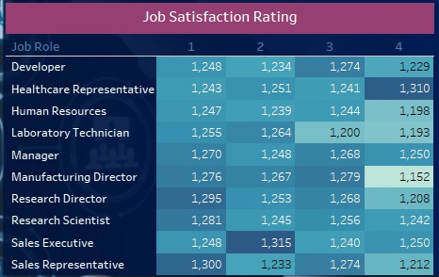
KPI 5-Job Role Vs Work life balance
Distribution of Work-Life Balance Ratings: The data displays the distribution of work-life balance ratings for various job roles. Each job role has ratings in each of the four categories (1 to 4).
Variability: There is variation in the work-life balance ratings for different job roles. For some roles, such as "Sales Representative" and "Sales Executive," there is a relatively even distribution across all four ratings. In contrast, roles like "Manufacturing Director" and "Research Director" show a more concentrated distribution in certain categories.
Lower Ratings: Job roles like "Sales Representative," "Laboratory Technician," and "Research Scientist" have a notable number of ratings in category 1, indicating that employees in these roles may perceive their work-life balance as less favorable.
Higher Ratings: On the other hand, roles like "Healthcare Representative," "Sales Executive," and "Manager" have a higher number of ratings in category 4, suggesting that employees in these roles tend to view their work-life balance more positively.
Work-Life Balance Perception: The data reveals that the perception of work-life balance can vary significantly among different job roles within the organization. Some roles are seen as more demanding in terms of work-life balance (lower ratings), while others are seen as more balanced and accommodating (higher ratings).
Focus on Specific Roles: The organization should pay special attention to roles where work-life balance ratings are lower, such as "Sales Representative," "Laboratory Technician," and "Research Scientist." These roles may need interventions to improve work-life balance and employee well-being.

Slide 8
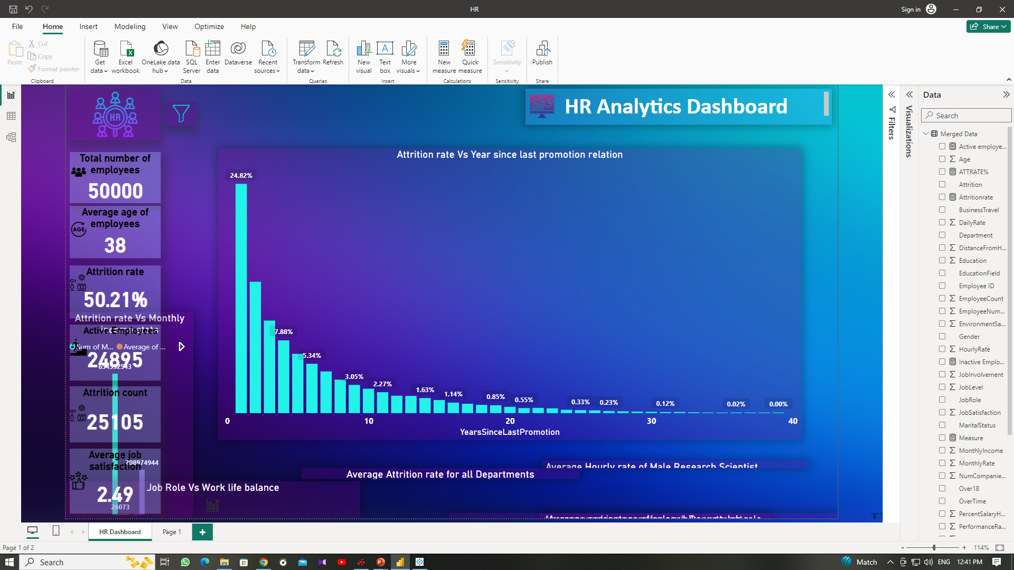
KPI 6-Attrition rate Vs Year since last promotion relation
Decreasing Attrition with Years Since Promotion: The data shows a clear trend of decreasing attrition as the number of years since the last promotion increases. In the first year after a promotion, the attrition rate is the highest at 24.82%, but it steadily decreases in subsequent years.
Attrition Stabilizes After Several Years: After around 10 years since the last promotion, the attrition rate stabilizes at a relatively low level, hovering around 2-3%. This suggests that employees who have been with the organization for a longer time after their last promotion are less likely to leave.
Long-Term Stability: In the data, after 20 years since the last promotion, the attrition rate decreases even further, reaching 0.68% and continues to decline. This indicates a strong level of long-term stability among employees who have remained with the organization for extended periods.
Continuous Monitoring: The organization should regularly monitor attrition rates based on years since the last promotion and make necessary adjustments to policies, training, and development programs to support employee growth and job satisfaction.
Long-Term Retention: Organizations should also focus on maintaining employee loyalty and commitment over the long term. After around 10 years since the last promotion, the attrition rate stabilizes at a relatively low level, signifying that employees are likely to stay for an extended duration if they are content with their roles and opportunities.

Slide 9
1. Recognition and Rewards: Implement recognition and reward programs to acknowledge and celebrate employee contributions. Feeling valued and appreciated at work can improve employee morale and reduce attrition.
8. Long-Term Incentives: Consider long-term incentive programs that reward employees for their extended tenure with the organization. This can be in the form of additional benefits, stock options, or unique privileges.
2. Communication and Transparency: Maintain open and transparent communication with employees. Keep them informed about company goals, changes, and initiatives. Feeling connected to the mission can improve employee engage organization’s retention.
7. Flexible Work Arrangements: Implement flexible work arrangements where feasible, such as remote work options, flexible hours, or compressed workweeks. This can help employees better balance their personal and professional lives.
8
3. Exit Interviews: Conduct exit interviews with departing employees to gather insights on their reasons for leaving. Use this feedback to make improvements and refine retention strategies.
Suggestions
6. Consistency in Average Total Working Years: The data indicates a relatively consistent average total working years across different departments, with values ranging from 20.30 to 20.65 years. This suggests that, on average, employees in these departments have a similar level of overall work experience.
4. Performance-Based Pay: Implement performance-based pay structures that reward high-performing employees with competitive compensation. This can help retain top talent and motivate others to excel.
5. Regular Salary Reviews: Implement regular salary reviews and adjustments to keep pace with changes in the job market and cost of living. This can prevent employees from feeling that their salaries are stagnant.

Slide 10

Thank you
Presenter’s name-Shoubhik Paul
Email address-shoubhikpaul@ymail.com

